Slide 1

SciX Online Summer Programs
Grades 9-12: Binary Calculator

Slide 2
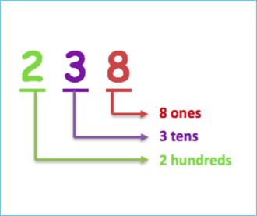
How do we count?
We count using 10 numbers…
0, 1, 2, 3, 4, 5, 6, 7, 8, 9
Counting with 10 digits is called decimal.
Notes:
What are the 10 different digits that we use in math? 0,1,2,3,4,5,6,7,8,9. When we count, we count through all of the 1-digit numbers first. After we run out of 1-digit numbers, we go onto 2-digit numbers. When we have exhausted all possible combinations of 2 digits, we go onto 3-digit numbers, and so on. This is a pattern that is similar in all ways of counting. Counting with all 10 digits is called decimal.
We count in base 10. This means that we use 10 different digits to make up every number. Digits are symbols that can be repeated in specific orders to make any number. So the number 632 has three digits: a six, a three, and a two. It is easy for us to count in base 10, but there are situations where we need to be able to work in different bases. Computers perform calculations by using electronic circuits. These circuits are made of transistors which work like little switches that can turn on to allow electricity to flow or turn off to stop the flow of electricity. If the transistor is on, it can be represented by a 1. If it is off, it can be represented by a 0. There is not option other than on and off. All code can be represented by 0’s and 1’s. This is why we say that computers “speak” in 0’s and 1’s.

Slide 3
How do computers count?
 | 8’s Place | Fours Place | Twos Place | Ones Place
0 |  |  |  | 0
1 |  |  |  | 1
2 |  |  | 1 | 0
3
4
Computers count in binary (0s and 1s)
The first two numbers are normal to us, 0, 1… What comes next? ___
Computers can’t use the number 2, they move onto the next digit. Computers represent the number 2 with “10” (one-zero)
There is one value in the “two’s place” and zero values in the one’s place
How do we represent the number three?
Notes:
Binary is another way of counting where we can only use 2 digits: 0 and 1. After we count the 1-digit numbers “0, 1, ” what comes next? We can’t say 2 because 2’s don’t exist in binary. We’ve run out of 1-digit numbers that we can use. We must go onto 2-digit numbers. The first 2-digit number is 10. Does 10 follow the rule that we can only use 0’s and 1’s? It does, so 10 is the next number in binary. 11 also follows this rule, so 11 is the next number. But 12 has a 2, so it is not a binary number. What is the next number that follows the rule that we can only use 1’s and 0’s? All other 2-digit numbers break the rule. 100 is the next number that follows the rule. This pattern continues, and we get an ordered list of numbers that only use 0’s and 1’s:

Slide 4
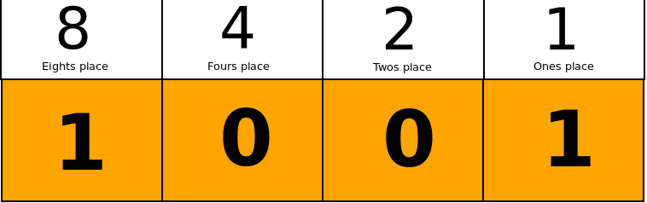
What decimal number does this represent?
Notes:
9

Slide 5
Binary Number
Decimal Number

Slide 6
Converting Bases
In binary, the important numbers that we want to use are the powers of 2: 1,2,4,8,16,32,…
Powers of 2 are the numbers you get by starting at 1 and continually doubling it.

Slide 7
Binary to Decimal
To convert a binary number to decimal, start from the farthest right digit and assign each digit a power of 2 starting from the right.
For example, lets convert 101010 to decimal:
If a digit is 1, add it’s assigned number, if it is a 0, skip it.
Binary | 1 | 0 | 1 | 0 | 1 | 0
Base # | 32 | 16 | 8 | 4 | 2 | 1
Notes:
For this example, we will add 2+8+32=42. So 101010 in decimal is 42.

Slide 8
Decimal to Binary
To convert the other way, start writing out our list of “special numbers” (32 16 8 4 2 1). As an example, we will convert 53 to binary.
Begin with 32. Can you subtract it from your decimal number? In our case, 53-32=21. Since we can subtract it, write a 1 under the 32. 21 becomes our new number.
Repeat for all of our special numbers.
Special Numbers
32 | 16 | 8 | 4 | 2 | 1
Notes:
Instructors should use the zoom whiteboard function to fill out the table and show calculations for the campers.

Slide 9
Lets try some more!
 | Special Numbers
Decimal Number | 32 | 16 | 8 | 4 | 2 | 1
53 | 1 | 1 | 0 | 1 | 0 | 1
66
75
21
32
43

Slide 10
Python and Math in Python:
Python is a programming language that we can use to write code. Open Wing on the computers. Wing is a python development environment. This means that is a place where we can write and run code in Python.
Lets try it out!

